Slide 1
WEB APPLICATION ARCHITECTURE Course code – CS545 **** Final Project
LECTURED BY Dr. Muhyieddin Al-Tarawneh

Slide 2
Mini online market……!!!!

Slide 3
Waa-Project
*Team Members*
1, Adam Zekariyas - 112235
2, Desta Wako - 111835
3, Efrem Abraha - 111691
4, Muna Teklemariam - 111765
5, Sirak Solomon - 112239
6, Yonas Abraha - 112346

Slide 4

React + Spring Boot Project
Feature | Score | Done
Admin
If the seller registers to the web site, he/she need to get approval from Admin in order to post products. | 2
The admin should approve the reviews that are made from the Buyers. | 1
Seller
Register as Seller | 2
Product (CRUD). If a product has already been purchased, it cannot be deleted. | 2
Seller cannot buy products from the website | 1
Maintain orders Cancel Order, the status of order on buyer’s part should also changed Change Order status (Shipped-On the way-Delivered) | 4

Slide 5
Buyer Score |  | Done
Register as Buyer | 2
Follow and Unfollow Seller | 2
Cannot sell items on this website | 1
Can place an order Maintain Shopping Cart (CRUD) Maintain Shipping and Billing Address Maintain Payment Place order Every successful purchase (not returned), gain points from the website. You can use points to buy products (something like coupons) | 5
Maintain Orders Check Order History Can cancel order before shipping, after shipping cannot Download/Print receipt as PDF or Excel Write Product Review. Review must be approved by Admin before live. | 4

Slide 6
General | Score | Done
Login/Logout | 2
Security with JWT (Users should not be able to access other pages links) | 4
Process verifications etc. (user get email of purchase, gets a message) | 2
Validation is required for all form submission. Otherwise, you’ll not get full credit on different feature part. | 2
Technical aspects
Neat code and organization | 2
Managed packages, folders, and files | 2

Slide 7
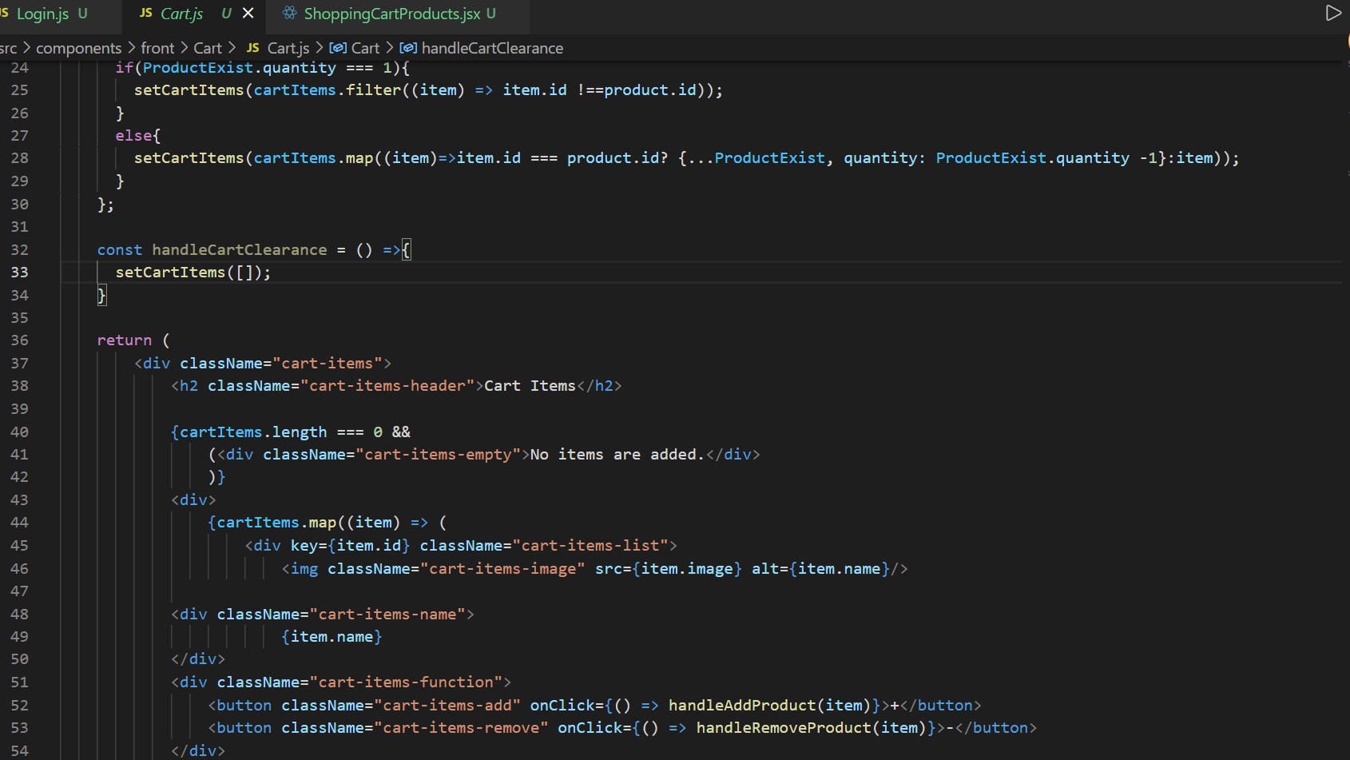
Some of the sample codes

Slide 8
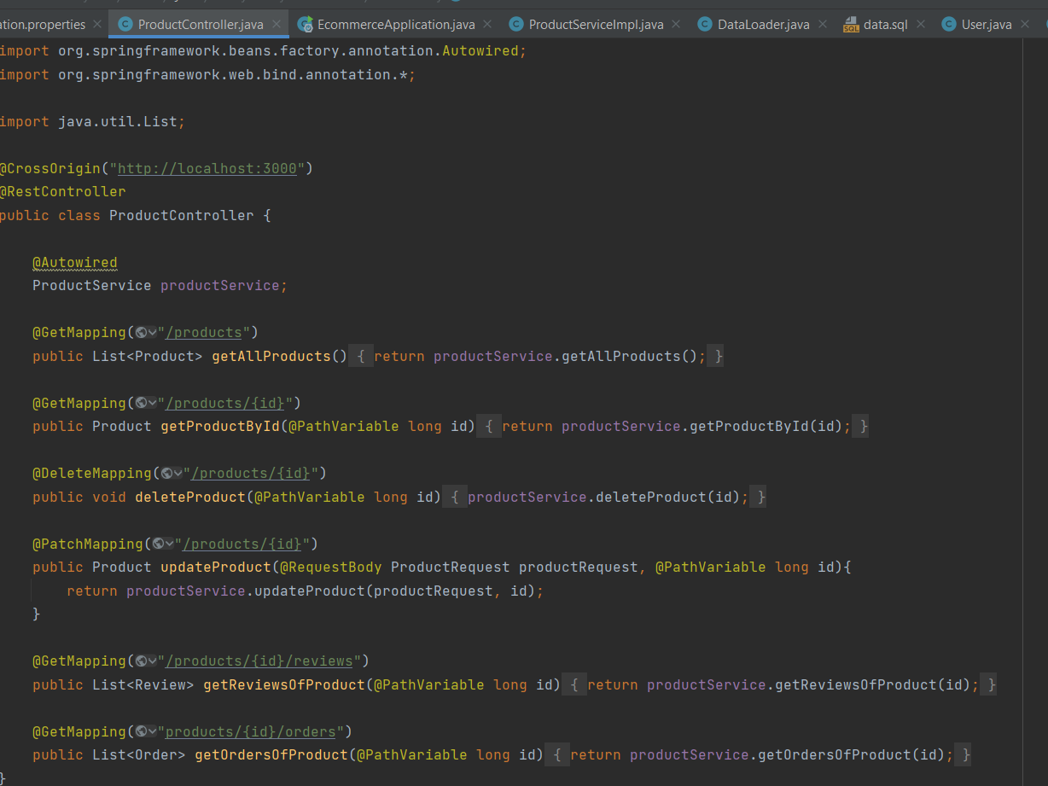
Some of the sample codes

Slide 9
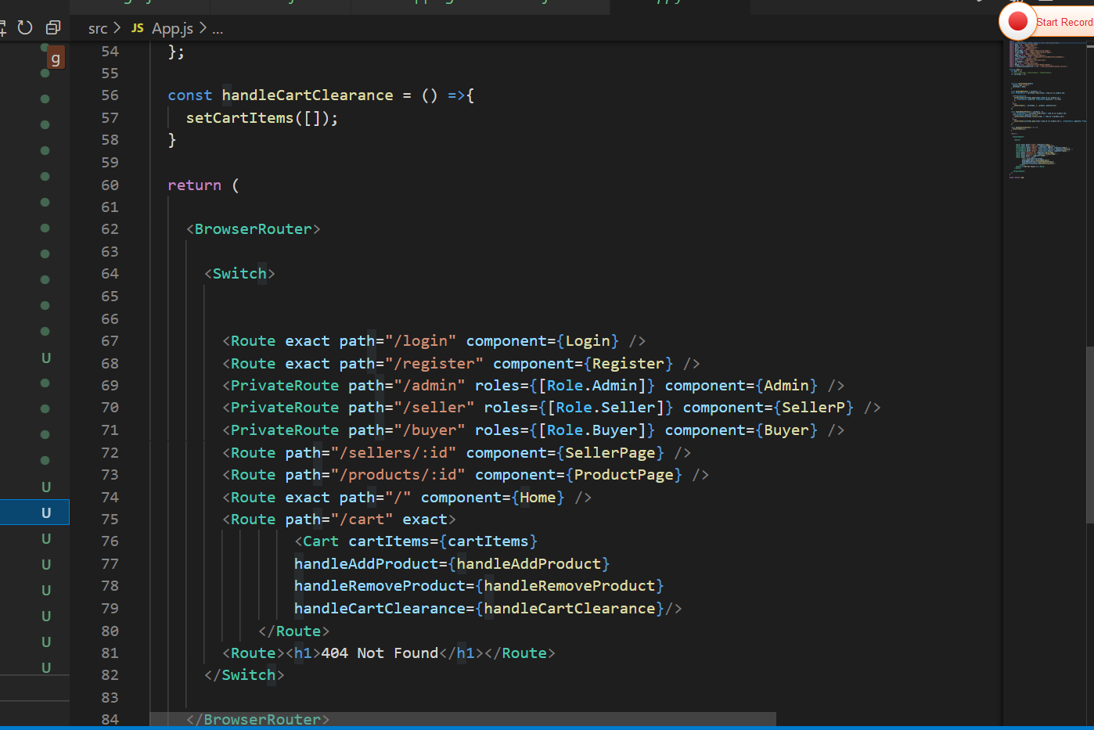
Some of the sample codes

Slide 10
Installation Instruction
Front-End
Extract the zip-file to your directory using WinRAR.
Go to the extracted folder and run the “Mini-Market – Frontend” in VS-code IDE.
Make sure to install all the necessary node_modules using “npm i” in your terminal.
And start your application using “npm start” in your terminal.
And make sure to run your application in default port “localhost:3000”.

Slide 11
BackEnd
Extract the zip-file to your directory using WinRAR.
Go to the extracted folder and run the “Mini-Market – Backend” in intelliJ IDE.
Build and run your application.
Demo on how to use the application is in the link below.

Slide 12
Tools and Technologies
*BackEnd
Java 11
Spring Boot
Spring Web MVC
Spring SESSION
MySql Database
Spring Data JPA
Hibernate
Maven

Slide 13
Tools and Technologies
* FrontEnd
"dependencies": {
"@material-ui/core": "^4.11.4",
"axios": "^0.21.1",
"cogo-toast": "^4.2.3",
"formik": "^2.2.6",
"jwt-decode": "^3.1.2",
"react": "^17.0.2",
"react-dom": "^17.0.2",
"react-hook-form": "^7.5.2",
"react-redux": "^7.2.4",
"react-router-dom": "^5.2.0",
"react-scripts": "^4.0.3",
"rxjs": "^6.3.3",
"web-vitals": "^1.1.2",
"yup": "^0.32.9"
},

Slide 14

conclusion
In conclusion we have try to implement all the spring boot and react tools, what we have learned in this course. It is a mind changing knowledge the power of Spring boot. It is manageable and easy to manipulate and develop any software.

